Slide 1
Chapter 2: Introduction to Relational Model
第2章 关系模型介绍
Yonghui Wu (吴永辉) yhwu@fudan.edu.cn

Slide 2
Review
Chapter 2 Relations in Discrete Mathematics “Set and Graph Theory”
1.3.3 Data Models（数据模型） in Chapter 1 Introduction

Slide 3
Outline
2.1 Structure of Relational Databases（关系数据库的结构）
2.2 Database Schema（数据库模式）
2.3 Keys（码、键、关键字）
2.4 Schema Diagrams（模式图）
2.5 Relational Query Languages（关系查询语言）
2.6 Realtional Operations（关系运算）
2.7 Summary

Slide 4
2.1 Structure of Relational Databases
A relational database consist of a collection of tables, each of which is assigned a unique name.
关系数据库由表的集合构成，每个表有唯一的名字。
实验作业：构建一个关系数据库

Slide 5
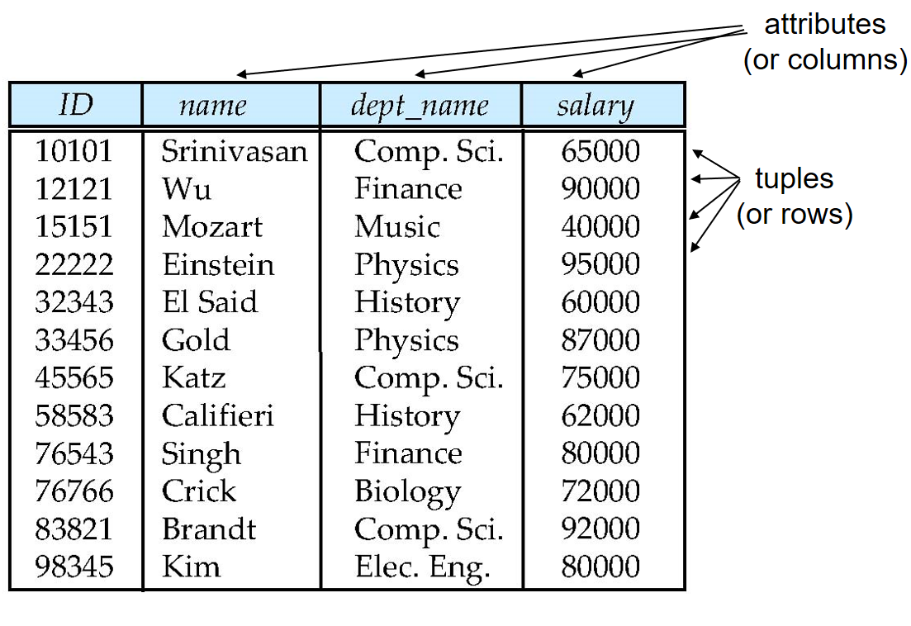
Example of a Relation: instructor

Slide 6
A row（行） in a table represents a relationship among a set of values.表中的一行代表了一组值之间的一种联系。
A table（表） is a collection of such relationships.
A tuple（元组） is a sequence (list) of values.
A relationship between n variables is represented by an n-tuple（n-元组） of value, i.e., a tuple with n values, which corresponds to a row in a table.

Slide 7
Relation（关系）: table;
Tuple（元组）: a row;
Attribute（属性）: a column of a table

Slide 8
Relation instance（关系实例）: a specific instance of relation, i.e., containing a specific set of rows

Slide 9
Attribute Types（属性类型）
The set of allowed values for each attribute is called the domain（域） of the attribute
Attribute values are (normally) required to be atomic（原子的）; that is, indivisible
The special value null is a member of every domain. Indicated that the value is “unknown” or doesn’t exist.（空值：未知或不存在）
The null value causes complications in the definition of many operations
  Cause difficulties when we access or update the database
  Should be eliminated if at all possible

Slide 10
2.2 Database Schema
Database Schema （数据库模式）
Database Instance（数据库实例）
Relation Schema （关系模式）

Slide 11
Relation Schema and Instance
A₁, A₂, …, A_{n} are attributes（属性）
R = (A₁, A₂, …, A_{n} ) is a relation schema（关系模式）
Example:
instructor = (ID, name, dept_name, salary)
Formally, given sets D₁, D₂, …. D_{n} a relation r is a subset of
D₁ x D₂ x … x D_{n}
Thus, a relation is a set of n-tuples (a₁, a₂, …, a_{n}) where each a_{i} ∈ D_{i}
The current values (relation instance) of a relation are specified by a table
An element t of r is a tuple, represented by a row in a table

Slide 12

Relations are Unordered
Order of tuples is irrelevant (tuples may be stored in an arbitrary order)
Example: instructor relation with unordered tuples

Slide 13
2.3 Keys（码）
Let K ⊆ R
K is a superkey （超码）of R if values for K are sufficient to identify a unique tuple of each possible relation r(R)
  Example: {ID} and {ID,name} are both superkeys of instructor.
Superkey K is a candidate key（候选码） if K is minimal
Example: {ID} is a candidate key for Instructor
One of the candidate keys is selected to be the primary key（主码）.
  which one?
Foreign key （外码）constraint: Value in one relation must appear in another
  Referencing relation
  Referenced relation
  Example – dept_name in instructor is a foreign key from instructor referencing department

Slide 14

2.4 Schema Diagram for University Database

Slide 15
2.5 Relational Query Languages
Procedural vs .non-procedural, or declarative
“Pure” languages:
  Relational algebra（关系代数）
  Tuple relational calculus（元组关系演算）
  Domain relational calculus（域关系演算）
The above 3 pure languages are equivalent in computing power
We will concentrate in this chapter on relational algebra
  Not turning-machine equivalent
  consists of 6 basic operations
6.1 Relational algebra

Slide 16
Relational algebra
Relational algebra defines a set of operations on relations.
Relational algebra provides a set of operations that take one or more relations as input and return a relation as output.
Practical query languages such as SQL are based on the relational algebra.
  关系代数是一种抽象的查询语言，用对关系的运算来表达查询，作为研究关系数据语言的数学工具。
  关系代数的运算对象是关系，运算结果亦为关系。关系代数用到的运算符包括四类：集合运算符、专门的关系运算符、算术比较符和逻辑运算符
  按照运算符的不同，主要将关系代数分为传统的集合运算和专门的关系运算两类。

Slide 17
关系代数之“传统的集合运算”
  传统的集合运算是二目运算，包括并、交、差、广义笛卡尔积四种运算。
关系代数之“专门的关系运算”
  专门的关系运算(Specific relation operations)包括选择、投影、连接、除等。

Slide 18

Select Operation – selection of rows (tuples)
选择操作
Relation r
σ_{A=B ^ D > 5} (r)

Slide 19

Project Operation – selection of columns (Attributes)
投影操作
Relation r:
∏_{A,C} (r)

Slide 20

Union of two relations
并
Relations r, s:
r ∪ s:

Slide 21

Set difference of two relations
集合差
Relations r, s:
r – s:

Slide 22

Set intersection of two relations
集合交
Relation r, s:
r ∩ s
Note: r ∩ s = r – (r – s)

Slide 23

joining two relations -- Cartesian-product
笛卡尔积
Relations r, s:
r x s:

Slide 24
Cartesian-product – naming issue
笛卡尔积
B
Relations r, s:
r.B
s.B
r x s:

Slide 25
Renaming a Table
Allows us to refer to a relation, (say E) by more than one name.
ρ _{x} (E)
returns the expression E under the name X
Relations r
r.A r.B s.A s.B
r x ρ _{s} (r)
α
α
β
β
1
1
2
2
α
β
α
β
1
2
1
2

Slide 26

Composition of Operations
Can build expressions using multiple operations
Example: σ_{A=C} (r x s)
r x s
σ_{A=C} (r x s)

Slide 27
Joining two relations – Natural Join
自然连接
Let r and s be relations on schemas R and S respectively.
Then, the “natural join” of relations R and S is a relation on schema R ∪ S obtained as follows:
  Consider each pair of tuples t_{r} from r and t_{s} from s.
  If t_{r} and t_{s} have the same value on each of the attributes in R ∩ S, add a tuple t to the result, where
    t has the same value as t_{r} on r
    t has the same value as t_{s} on s
在具有相同名字的所有属性上取值相同

Slide 28

Natural Join Example
Relations r, s:
Natural Join
  r s
∏ _{A, r.B, C, r.D, E} (σ _{r.B = s.B ˄ r.D = s.D} (r x s)))

Slide 29
Notes about Relational Languages
Each Query input is a table (or set of tables)
Each query output is a table.
All data in the output table appears in one of the input tables
Relational Algebra is not Turning complete
Can we compute:
  SUM
  AVG
  MAX
  MIN

Slide 30
Summary of Relational Algebra Operators
Symbol (Name) Example of Use
σ
(Selection) ^{σ} salary > = 85000 ^{(instructor)}
Return rows of the input relation that satisfy the predicate.
Π
(Projection) ^{Π} ID, salary ^{(instructor)}
Output specified attributes from all rows of the input relation. Remove duplicate tuples from the output.
x
(Cartesian Product) instructor x department
Output pairs of rows from the two input relations that have the same value on all attributes that have the same name.
∪
(Union) ^{Π} name ^{(instructor) ∪ Π} name ^{(student)}
Output the union of tuples from the two input relations.
-
(Set Difference) ^{Π} name ^{(instructor)} ^{-- Π} name ^{(student)}
Output the set difference of tuples from the two input relations.
⋈
(Natural Join) instructor ⋈ department
Output pairs of rows from the two input relations that have the same value on all attributes that have the same name.

Slide 31
End of Chapter 2

